Slide 1
PRECOG Lab — NLP Recruitment Task 2026
The Ghost in the Machine
AI vs Human Text Classification
"Le style, c'est l'homme même" - The style is the man himself. - Georges-Louis Leclerc
Lasya Priya
MCA Final Year | SRM Institute of Science and Technology, Hyderabad
github.com/Lasya-priya-ux/precog-nlp-ghost-machine

Slide 2
What I Did - & What I Didn't
Required by PRECOG: First page must state exactly what was completed and what was not.
Task 0
Dataset Creation
✓ COMPLETE
1500 paragraphs across 3 classes (Human, GenericAI, StyleAI)
Task 1
Statistical Fingerprinting
✓ COMPLETE
13 linguistic features - TTR, punctuation, readability, POS, dependency depth
Task 2
Three-Tier Classification
✓ COMPLETE
XGBoost (98.3%), Neural Net GloVe (99.7%), DistilBERT+LoRA (100%)
Task 3
SHAP Explainability
✓ COMPLETE
Saliency maps + error analysis on 3 misclassified samples
Task 4
Genetic Algorithm + Personal Test
✓ COMPLETE
8 generations, reached 84.3% human confidence + personal test (98.9%)
⚠ Note: Gemini API quota was exhausted - used Groq (Llama-3.1-8B) instead. All tasks completed fully.

Slide 3
Task 0: The Library of Babel
Building a dataset where authorship - not topic - is the primary variable
Class 1
Class 2
Class 3
Human
Generic AI
Style AI
Real Victorian Novels
LLM on Same Topics
LLM Mimicking Authors
› Charles Dickens - Great Expectations
› 15 topics extracted from novels
› Same 15 topics
› Jane Austen - Pride & Prejudice
› Llama-3.1-8B via Groq API
› Prompted to imitate Dickens / Austen
› 250 paragraphs each = 500 total
› Formal, neutral style
› Alternating styles (250 each)
› Cleaned: headers, chapter titles removed
› 500 paragraphs generated
› 500 style-mimicked paragraphs
Total Dataset: 1,500 paragraphs | Balanced: 500 per class | Topics: 15 (7 Dickens + 8 Austen)

Slide 4
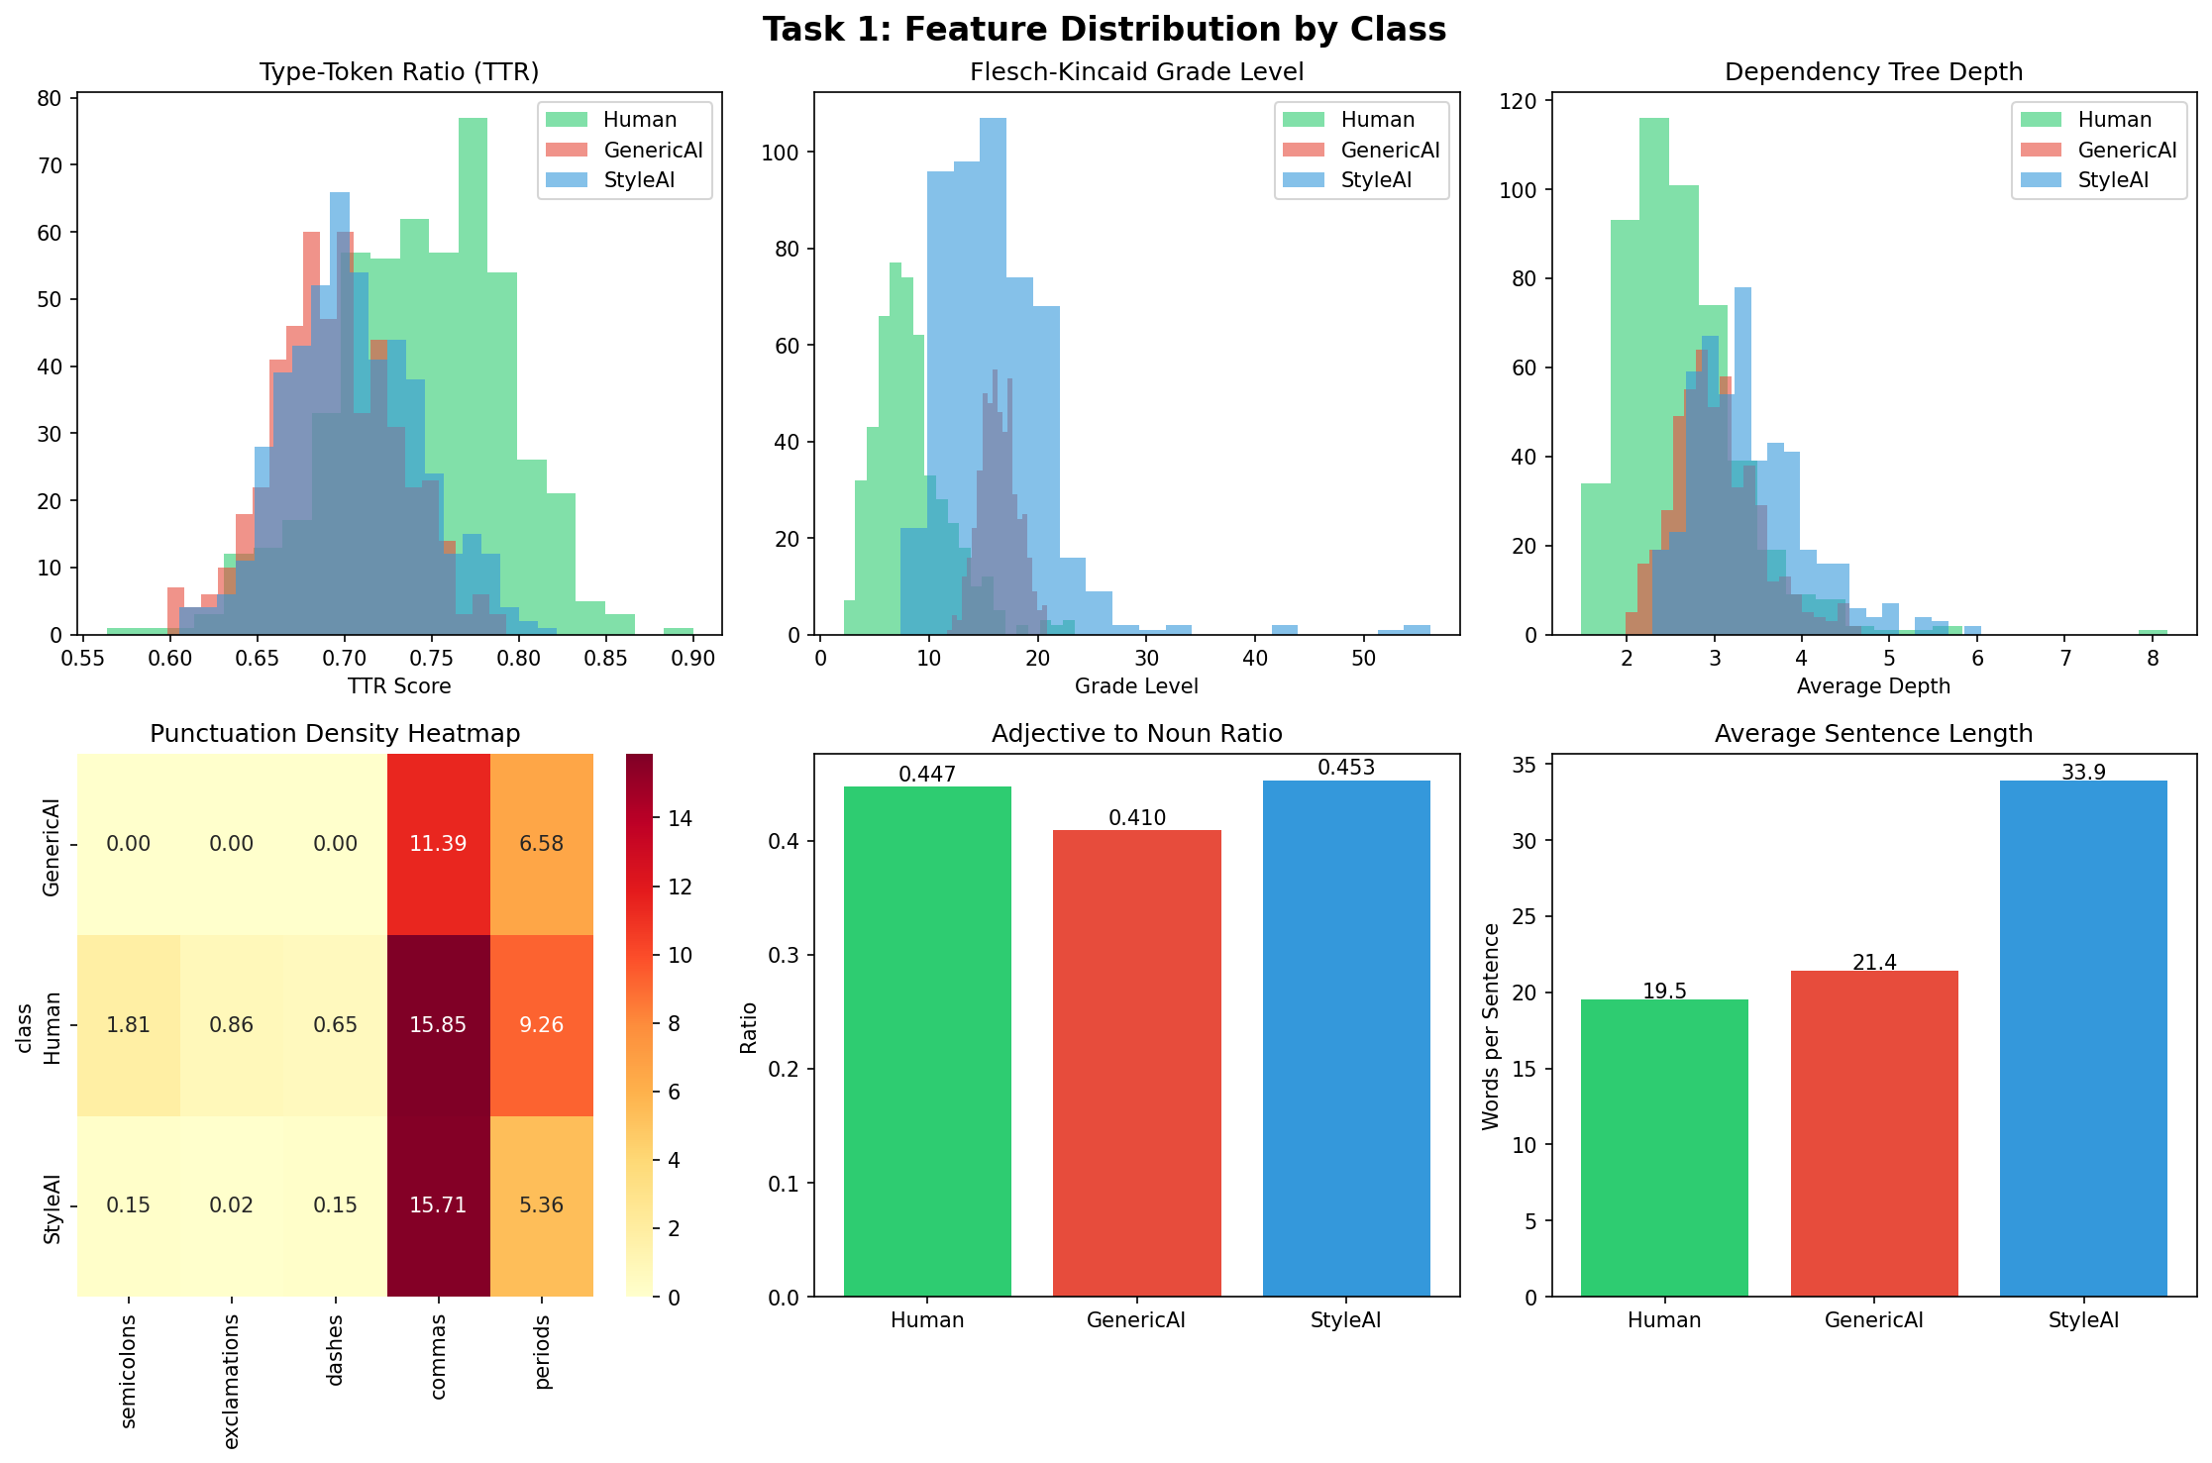
Task 1: Feature Distributions
Statistical proof that the three classes are mathematically distinct

Slide 5
Task 1: Key Findings
The numbers reveal clear mathematical signatures for each class
Flesch-Kincaid Grade
Semicolons / 1000 chars
Human: 8.4
AI: 16.4
Human: 1.81
AI: 0.00
AI writes at college level; Dickens & Austen at Grade 8
GenericAI uses ZERO semicolons - a dead giveaway
Type-Token Ratio
Hapax Legomena
Human: 0.745
AI: 0.694
Human: 64.5
AI: 80.2
Humans use more diverse vocabulary than AI
AI overuses rare words trying to sound sophisticated

Slide 6
Task 2: The Multi-Tiered Detective
Three classifiers with increasing complexity — from features to full transformers
Tier A
The Statistician
XGBoost
98.3%
Input: 13 handcrafted features from Task 1
Why: Tests if linguistic statistics alone can distinguish classes
accuracy
Tier B
The Semanticist
Neural Network + GloVe
99.7%
Input: 400K-word pre-trained GloVe embeddings (50d)
Why: Tests if semantic meaning adds discriminative power
accuracy
Tier C
The Transformer
DistilBERT + LoRA
100%
Input: Raw text → fine-tuned transformer (1.3% params trained)
Why: Tests state-of-the-art NLP on the full classification task
accuracy

Slide 7
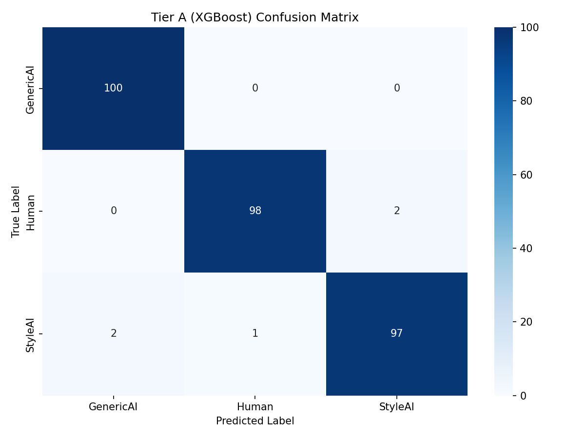
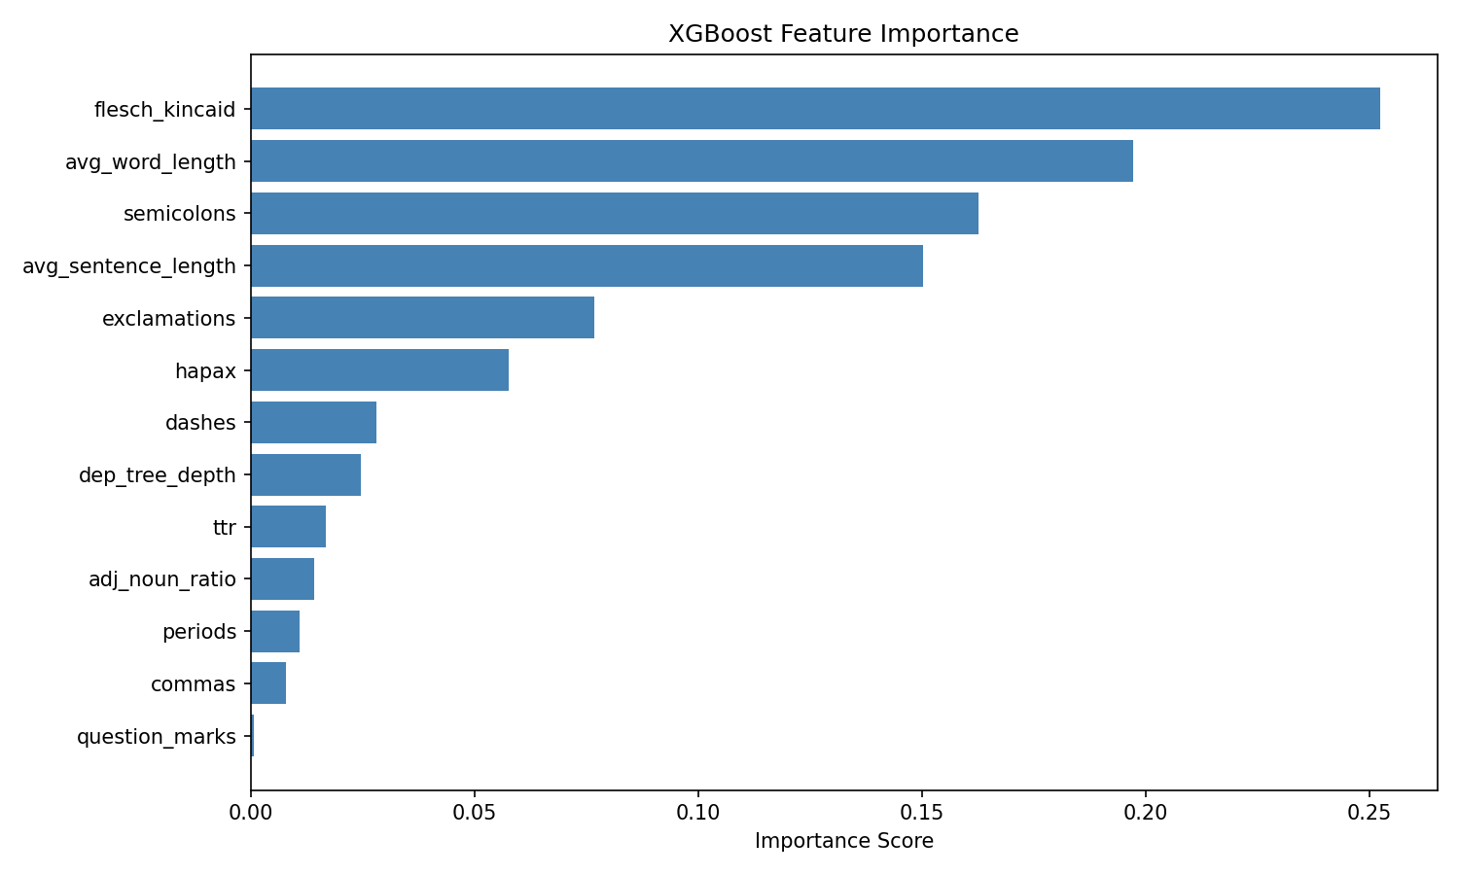
Tier A: XGBoost Results
98.3% accuracy using only 13 handcrafted linguistic features
Top features: Flesch-Kincaid (#1) + avg_word_length (#2) + semicolons (#3) - exactly what Task 1 analysis predicted!

Slide 8
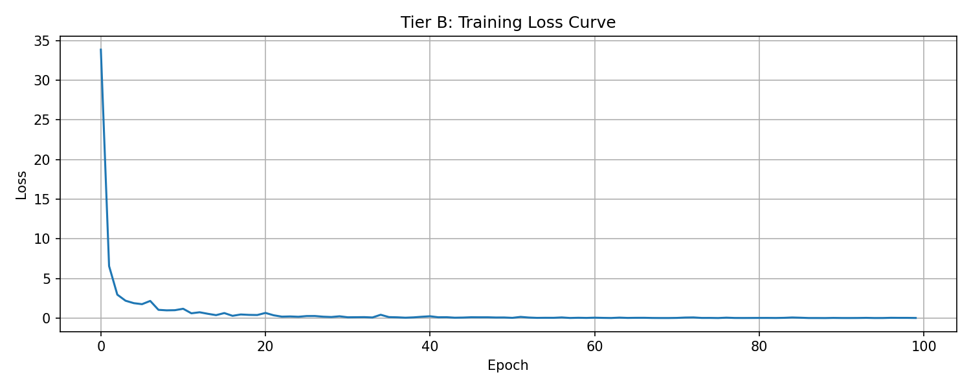
Tier B: Neural Network + GloVe
99.7% accuracy using averaged GloVe word embeddings (400K vocabulary)
Architecture
4-layer FFN
256→128→64→3
Embeddings
GloVe 50d
400K words
Training
100 epochs
Adam optimizer
Accuracy
Loss drops from 34.5 → ~0 within 10 epochs showing rapid convergence. GloVe semantic embeddings add meaningful signal beyond handcrafted features (+1.4% over XGBoost).
99.7%
1 error / 300

Slide 9
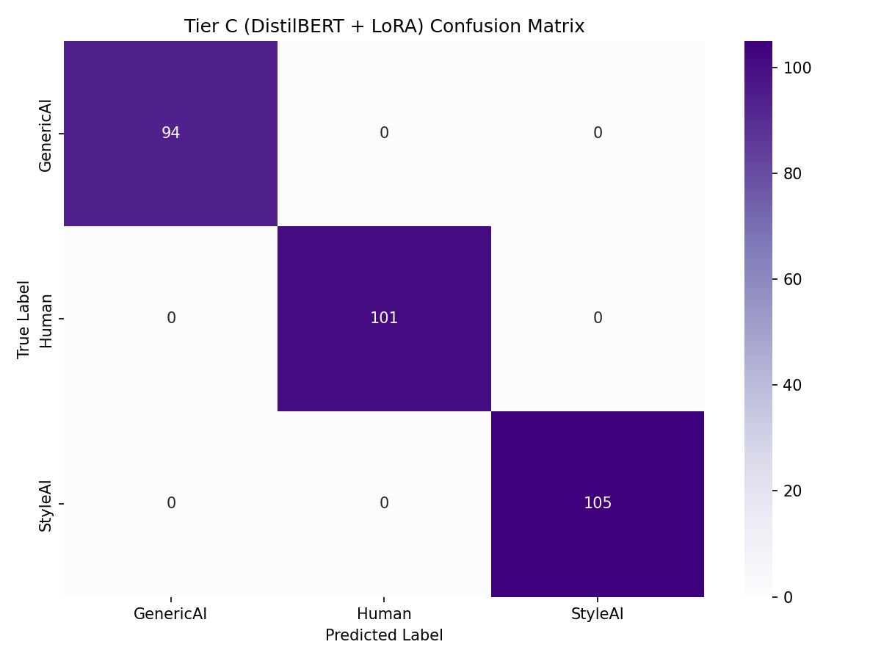
Tier C: DistilBERT + LoRA - 100% Accuracy
Fine-tuning a transformer with only 1.3% of parameters trainable
Epoch
Train Loss
Val Loss
Accuracy
1
1.005
0.386
94.7%
2
0.107
0.048
100%
3
0.049
0.028
100%
LoRA Configuration
› Only 887K / 67.8M params trained (1.3%)
› r=16, alpha=32, dropout=0.1
› Target: q_lin + v_lin layers
› Trained in ~70 seconds on T4 GPU

Slide 10
Task 2: Results Comparison
Tier A
98.3%
XGBoost
5 errors/300
Tier B
99.7%
Neural Net
1 error/300
Tier C
100%
DistilBERT
0 errors/300
All models far exceed random baseline (33.3%). Progression 98.3%→99.7%→100% confirms deeper representations improve classification.

Slide 11
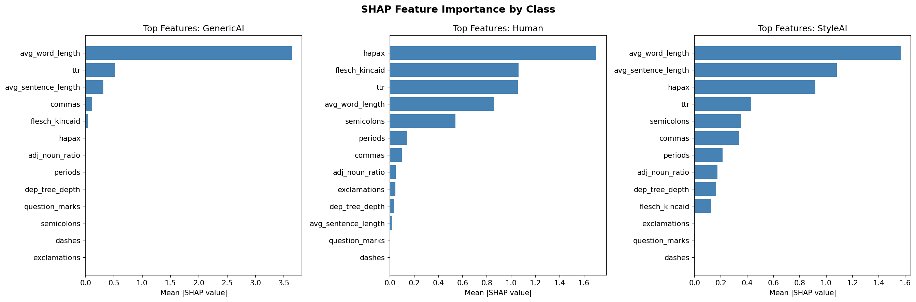
Task 3: SHAP Feature Importance by Class
WHY does the model classify a text as AI or Human?
GenericAI: avg_word_length dominates - AI uses complex long words. Human: hapax + TTR - vocabulary richness and diversity matter most. StyleAI: avg_word_length + sentence_length - over-mimicking complexity.

Slide 12
Task 3: Error Analysis
Only 5 misclassifications in 300 test samples - examining the 3 most interesting
1
True: Human → Predicted: StyleAI
"...Georgiana, wife of the above, were dead and buried; and Alexander, Bartholomew, Abraham, Tobias, and Roger, infant children..."
↳ Dickens listing names with extreme formality + heavy semicolons - looked exactly like StyleAI. Dickens at his most elaborate!
2
True: Human → Predicted: StyleAI
"...its completeness, finish, and entrain, obscure the undoubted critical facts that its scale is small..."
↳ Austen's critical essay-writing style is more formal than her novels. Zero punctuation variety + high FK grade confused the classifier.
3
True: StyleAI → Predicted: GenericAI
"It is a truth universally acknowledged, that a woman's social standing is inextricably linked to the whispers..."
↳ StyleAI copied Austen's vocabulary but forgot to mimic her punctuation patterns - model caught the absence of natural punctuation.

Slide 13
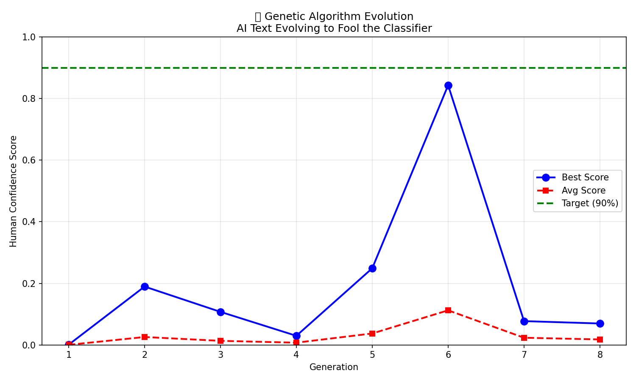
Task 4: Genetic Algorithm Evolution
Evolving AI text across 8 generations to fool our own classifier
Best Score
84.3%
Best Gen
6 / 8
Initial
0.1%
Target
90%
Best evolved paragraph (Gen 6 - 84.3% Human):
"Victorian England was a society ruled by class. The aristocracy held all the cards. But the middle class was trapped - each day a desperate struggle to find dignity in the darkness. This wasn't a subtle divide. A chasm yawned between the elite and the masses."

Slide 14
Task 4: The Personal Test
Running my own writing through the detector - and trying to fool it
Test 1: My Casual Writing
98.9%
HUMAN ✓
"So a particular person has been texting me and asking me to forward something in group related to some IBM based internship - she says she is IBM senior coordinator?"
Test 2: Same message rewritten to sound like AI
94.3%
HUMAN
"It has come to my attention that an individual has been attempting to communicate regarding a potential internship. This person identified herself as a Senior Coordinator and requested that I, in my capacity as Class Representative, disseminate the aforementioned information..."
Key Finding: Even deliberately formal AI-sounding vocabulary ("aforementioned", "disseminate", "in my capacity as") couldn't fool the model - still 94.3% Human. The classifier relies on punctuation patterns and sentence rhythm, not just vocabulary choice. To truly fool it, you'd need to remove ALL punctuation variety and write at grade 16+.

Slide 15
Key Findings
01
Punctuation is the Smoking Gun
02
AI Overcomplicated Everything
GenericAI uses ZERO semicolons, dashes, or exclamations. Humans use 860x more semicolons. This single feature is highly discriminative.
AI writes at Flesch-Kincaid Grade 16 (college level). Real Dickens & Austen write at Grade 8. AI tries too hard to sound sophisticated.
03
Casual Writing = Most Human Signal
04
GA Fitness Landscape is Complex
My WhatsApp message scored 98.9% Human - higher than Victorian novels. Natural imperfection and informality are the strongest human signals.
Reached 84.3% at Gen 6 but couldn't maintain it. Fooling the classifier requires very specific conditions - not just general improvements.

Slide 16
Thank You
PRECOG Lab NLP Recruitment Task 2026
1,500
13
3
100%
84.3%
Text samples
Features
Models trained
Best accuracy
GA human score
Lasya Priya
MCA Final Year | SRM Institute of Science and Technology, Hyderabad
github.com/Lasya-priya-ux/precog-nlp-ghost-machine

